Slide 1


Building a modern Application w/ DataFrames
Meetup @ [24]7 in Campbell, CA
Sept 8, 2015

Slide 2

Who am I?
Sameer Farooqui
Trainer @ Databricks
150+ trainings on Hadoop, C*, HBase, Couchbase, NoSQL, etc
Google: “spark newcircle foundations” / code: SPARK-MEETUPS-15

Slide 3

Who are you?
1) I have used Spark hands on before…
2) I have used DataFrames before (in any language)…

Slide 4
Agenda
Be able to smartly use DataFrames tomorrow!
+ Intro
+ Advanced
Spark Overview
Demo!
Catalyst Internals
DataFrames
(10 mins)

Slide 5



The Databricks team contributed more than 75% of the code added to Spark in the past year

Slide 6
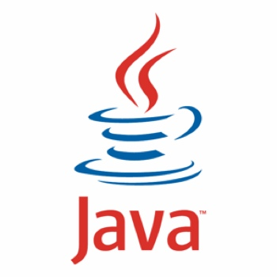

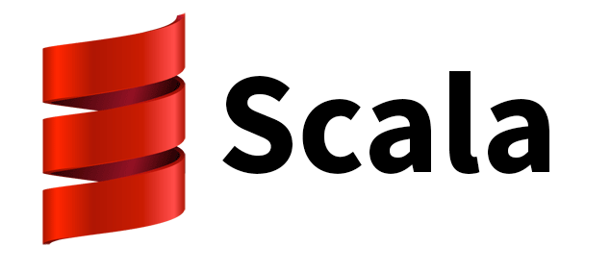



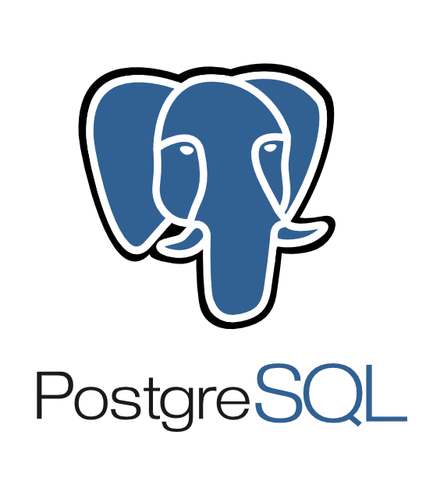
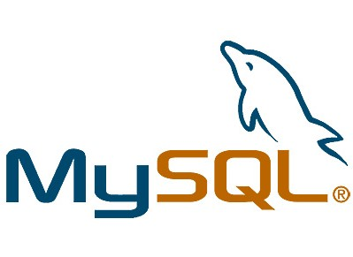




DataFrames API
Spark SQL
Spark Streaming
MLlib
GraphX
RDD API
Spark Core
Data Sources
{JSON}

Slide 7
Goal: unified engine across data sources, workloads and environments

Slide 8





















Spark – 100% open source and mature
Used in production by over 500 organizations. From fortune 100 to small innovators

Slide 9
Contributors per Month to Spark
Most active project in big data

Slide 10
2014: an Amazing Year for Spark
Total contributors: 150 => 500
Lines of code: 190K => 370K
500+ active production deployments

Slide 11




Large-Scale Usage
Largest cluster:
8000 nodes
Largest single job:
1 petabyte
Top streaming intake:
1 TB/hour
2014 on-disk 100 TB sort record

Slide 12


On-Disk Sort Record: Time to sort 100TB
2013 Record: Hadoop
2100 machines
72 minutes
2014 Record: Spark
207 machines
23 minutes
Source: Daytona GraySort benchmark, sortbenchmark.org
Notes:
This saturated both disk and network layers

Slide 13
Spark Physical Cluster
Spark Driver
JVM
Executor
Executor
Executor
Executor
Task
Task
Task
Task
Task
Task
Task
Task
JVM
JVM
JVM
JVM

Slide 14
Spark Data Model
RDD with 4 partitions
Error, ts, msg1
Warn, ts, msg2
Error, ts, msg1
Info, ts, msg8
Warn, ts, msg2
Info, ts, msg8
Error, ts, msg3
Info, ts, msg5
Info, ts, msg5
Error, ts, msg4
Warn, ts, msg9
Error, ts, msg1
logLinesRDD
Notes:
Old Spark API (T&A) is based on Java/Python objects
- this makes it hard for the engine to store compactly (java objects in memory have a lot of extra space for what classes, pointers to various things, etc)
- cannot understand semantics of user functions
- so if you run a map function over just one field of the data, it still has to read the entire object into memory. Spark doesn't know you only cared about one field.

Slide 15
Spark Data Model
more partitions = more parallelism
item-1
item-2
item-3
item-4
item-5
item-6
item-6
item-8
item-9
item-10
RDD
Ex
Ex
Ex
RDD
RDD
RDD
RDD
RDD

Slide 16
DataFrame APIs
Notes:
DataFrames were inspired by previous distributed data frame efforts, including Adatao’s DDF and Ayasdi’s BigDF. However, the main difference from these projects is that DataFrames go through the Catalyst optimizer, enabling optimized execution similar to that of Spark SQL queries.

Slide 17

Spark Data Model
DataFrame with 4 partitions
Type
Time
Msg
Type
Time
Msg
Type
Time
Msg
Type
Time
Msg
(Str)
(Int)
(Str)
(Str)
(Int)
(Str)
(Str)
(Int)
(Str)
(Str)
(Int)
(Str)
Error
ts
msg1
Info
ts
msg7
Warn
ts
msg0
Error
ts
msg1
Warn
ts
msg2
Warn
ts
msg2
Warn
ts
msg2
Error
ts
msg3
Error
ts
msg1
Error
ts
msg9
Info
ts
msg11
Error
ts
msg1
logLinesDF
df.rdd.partitions.size = 4
Notes:
a DataFrame is a distributed collection of data organized into named columns. It is conceptually equivalent to a table in a relational database or a data frame in R/Python, but with richer optimizations under the hood.
I’d say that DataFrame is a result of transformation of any other RDD. Your input RDD might contains strings and numbers. But as a result of transformation you end up with RDD that contains GenericRowWithSchema, which is what DataFrame actually is. So, I’d say that DataFrame is just sort of wrapper around simple RDD, which provides some additional and pretty useful stuff.

Slide 18
Spark Data Model
more partitions = more parallelism
- - -
- - -
- - -
- - -
- - -
E T M
E T M
E T M
E T M
E T M
E T M
E T M
E T M
E T M
E T M
DataFrame
Ex
Ex
Ex
DF
DF
DF
DF
DF

Slide 19
DataFrame Benefits
Easier to program
Significantly fewer Lines of Code
Improved performance
via intelligent optimizations and code-generation

Slide 20


Write Less Code: Compute an Average
private IntWritable one =
new IntWritable(1)
private IntWritable output =
new IntWritable()
proctected void map(
LongWritable key,
Text value,
Context context) {
String[] fields = value.split("\t")
output.set(Integer.parseInt(fields[1]))
context.write(one, output)
}
IntWritable one = new IntWritable(1)
DoubleWritable average = new DoubleWritable()
protected void reduce(
IntWritable key,
Iterable<IntWritable> values,
Context context) {
int sum = 0
int count = 0
for(IntWritable value : values) {
sum += value.get()
count++
}
average.set(sum / (double) count)
context.Write(key, average)
}
data = sc.textFile(...).split("\t")
data.map(lambda x: (x[0], [x.[1], 1])) \
.reduceByKey(lambda x, y: [x[0] + y[0], x[1] + y[1]]) \
.map(lambda x: [x[0], x[1][0] / x[1][1]]) \
.collect()
Notes:
To compute an average. I have a dataset that is a list of names and ages. Want to figure out the average age for a given name. So, age distribution for a name…

Slide 21
Write Less Code: Compute an Average
Using RDDs
data = sc.textFile(...).split("\t")
data.map(lambda x: (x[0], [int(x[1]), 1])) \
.reduceByKey(lambda x, y: [x[0] + y[0], x[1] + y[1]]) \
.map(lambda x: [x[0], x[1][0] / x[1][1]]) \
.collect()
Full API Docs
Python
Scala
Java
R
Using DataFrames
sqlCtx.table("people") \
.groupBy("name") \
.agg("name", avg("age")) \
.collect()

Slide 22

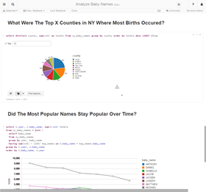
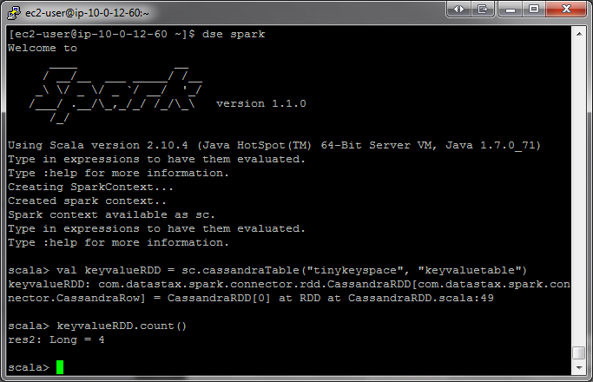

DataFrames are evaluated lazily
- - -
- - -
- - -
E T M
E T M
E T M
E T M
E T M
E T M
DF-1
- -
- -
- -
E T
E T
E T
E T
E T
E T
DF-2
- -
- -
- -
E T
E T
E T
or
E T
E T
E T
DF-3
Distributed Storage

Slide 23
DataFrames are evaluated lazily
Catalyst + Execute DAG!
or
Distributed Storage

Slide 24
DataFrames are evaluated lazily
- - -
- - -
- - -
E T M
E T M
E T M
E T M
E T M
E T M
DF-1
- -
- -
- -
E T
E T
E T
E T
E T
E T
DF-2
- -
- -
- -
E T
E T
E T
or
E T
E T
E T
DF-3
Distributed Storage

Slide 25
Transformations, Actions, Laziness
DataFrames are lazy. Transformations contribute to the query plan, but they don't execute anything.
Actions cause the execution of the query.
Transformation examples
Action examples
filter
select
drop
intersect
join
count
collect
show
head
take
Notes:
Head is non-deterministic, could change between jobs. Just the first partition that materialized returns results.

Slide 26
3 Fundamental transformations on DataFrames
mapPartitions()
New ShuffledRDD
ZipPartitions()
Notes:
Head is non-deterministic, could change between jobs. Just the first partition that materialized returns results.

Slide 27
SQL
Graduated from Alpha in 1.3
Spark SQL
Part of the core distribution since Spark 1.0 (April 2014)

Slide 28

Which context?
SQLContext
HiveContext
Basic functionality
More advanced
Superset of SQLContext
More complete HiveQL parser
Can read from Hive metastore + tables
Access to Hive UDFs
Improved multi-version support in 1.4
Notes:
SparkSQL is the only project (1.4+) can read from multiple version of Hive. Spark 1.5 can read from 0.12 – 1.2
A lot of the hive functionality is useful even if you don’t have a Hive installation! Spark will automatically create a local copy of the Hive metastore so use can use Window functions, Hive UDFS, create persistent tables,
To use a HiveContext, you do not need to have an existing Hive setup, and all of the data sources available to a SQLContext are still available. HiveContext is only packaged separately to avoid including all of Hive’s dependencies in the default Spark build.
The specific variant of SQL that is used to parse queries can also be selected using the spark.sql.dialect option. This parameter can be changed using either the setConf method on a SQLContext or by using a SET key=valuecommand in SQL. For a SQLContext, the only dialect available is “sql” which uses a simple SQL parser provided by Spark SQL. In a HiveContext, the default is “hiveql”, though “sql” is also available.

Slide 29


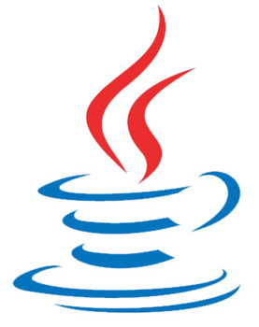
Construct a DataFrame
# Construct a DataFrame from a "users" table in Hive.
df = sqlContext.read.table("users")
# Construct a DataFrame from a log file in S3.
df = sqlContext.read.json("s3n://someBucket/path/to/data.json", "json")
val people = sqlContext.read.parquet("...")
DataFrame people = sqlContext.read().parquet("...")
Notes:
The following example shows how to construct DataFrames in Python. A similar API is available in Scala and Java.

Slide 30
Use DataFrames
# Create a new DataFrame that contains only "young" users
young = users.filter(users["age"] < 21)
# Alternatively, using a Pandas-like syntax
young = users[users.age < 21]
# Increment everybody's age by 1
young.select(young["name"], young["age"] + 1)
# Count the number of young users by gender
young.groupBy("gender").count()
# Join young users with another DataFrame, logs
young.join(log, logs["userId"] == users["userId"], "left_outer")
Notes:
Once built, DataFrames provide a domain-specific language for distributed data manipulation. Here is an example of using DataFrames to manipulate the demographic data of a large population of users:

Slide 31
DataFrames and Spark SQL
young.registerTempTable("young")
sqlContext.sql("SELECT count(*) FROM young")
Notes:
You can also incorporate SQL while working with DataFrames, using Spark SQL. This example counts the number of users in the young DataFrame.

Slide 32
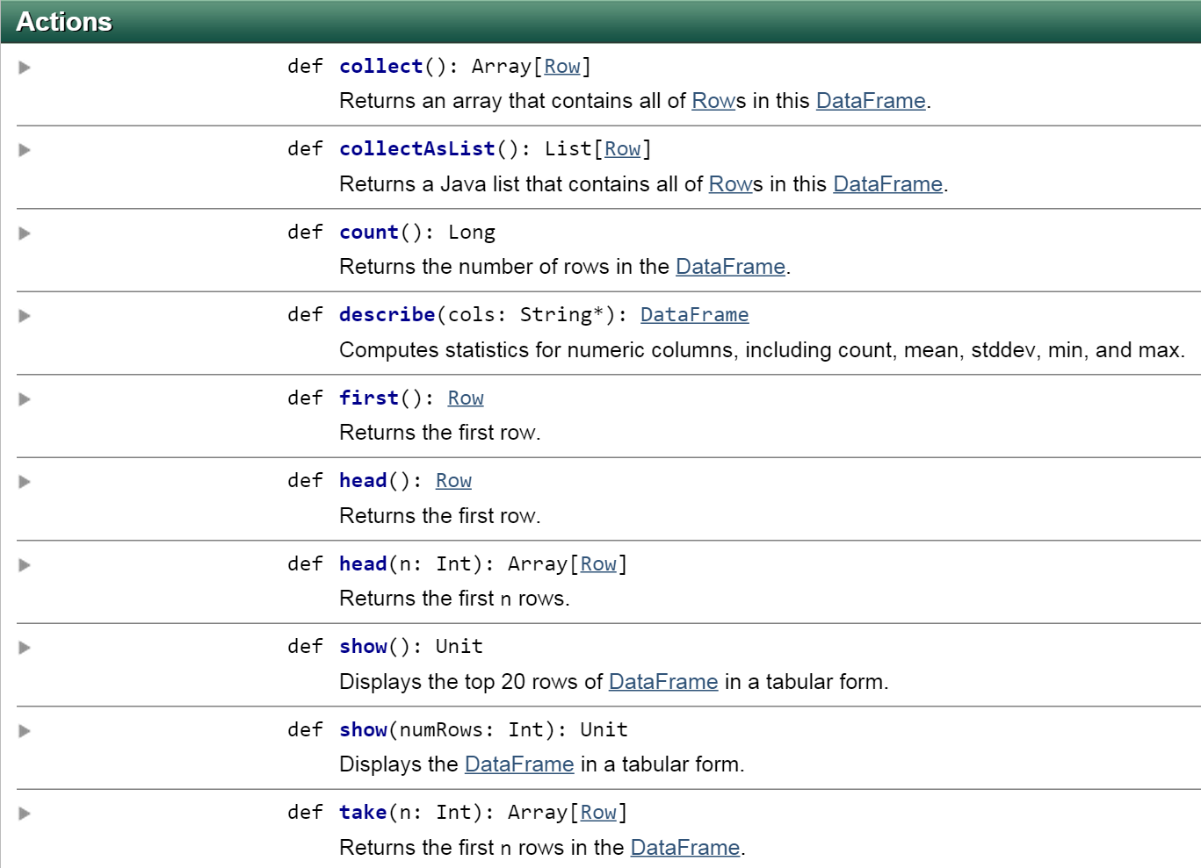
Actions on a DataFrame

Slide 33
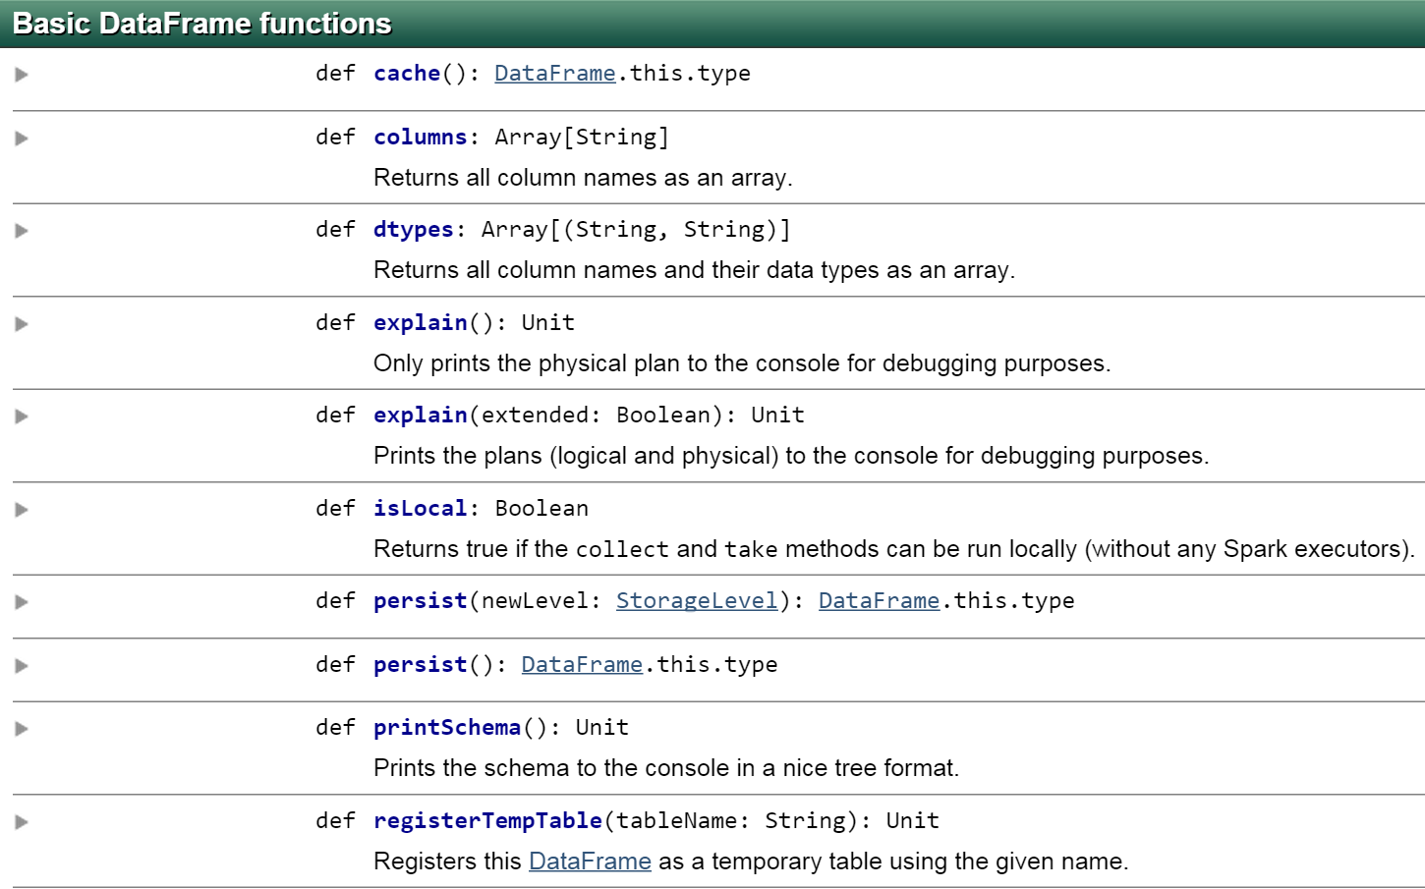
Functions on a DataFrame
Notes:
But its not the same as if you called .cache() on an RDD[Row], since we reencode the data into bytebuffers before calling caching so that there is less pressure on the GC.

Slide 34
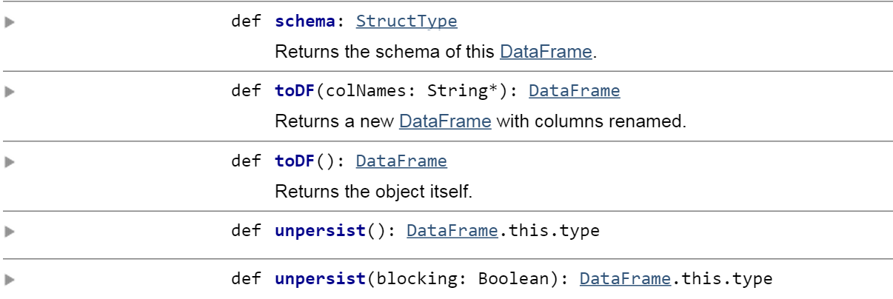
Functions on a DataFrame

Slide 35
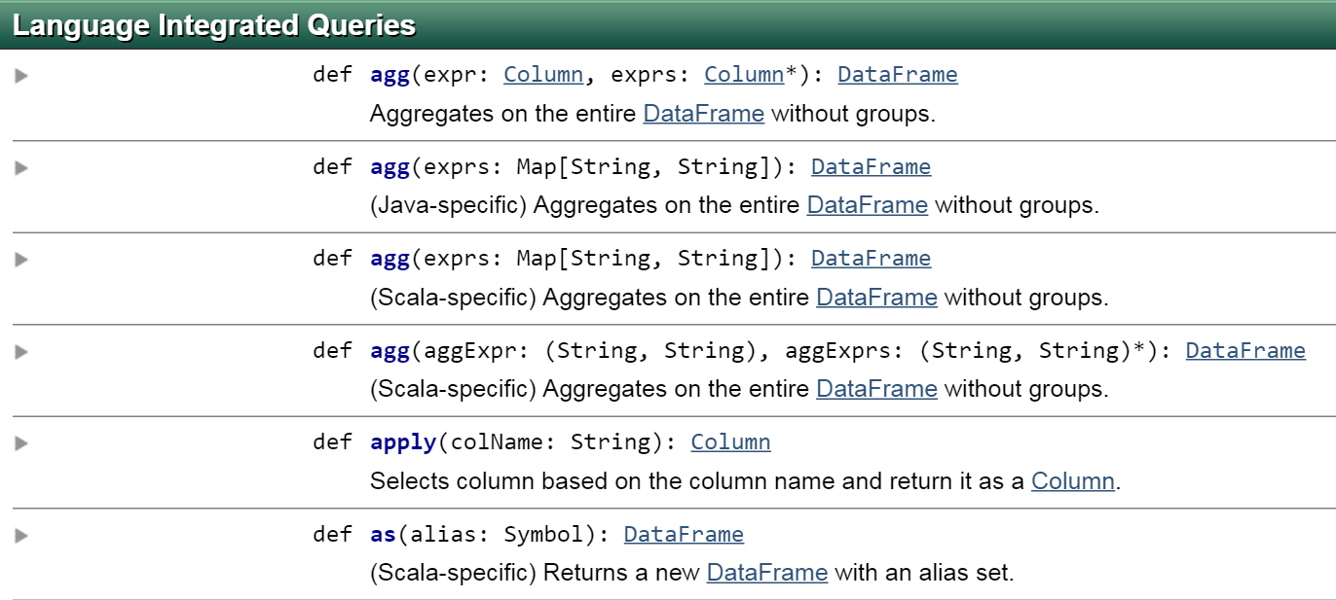
Queries on a DataFrame
https://spark.apache.org/docs/latest/api/scala/index.html#org.apache.spark.sql.DataFrame

Slide 36

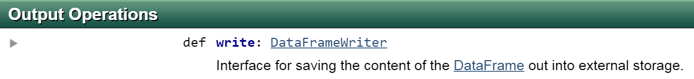

Slide 37
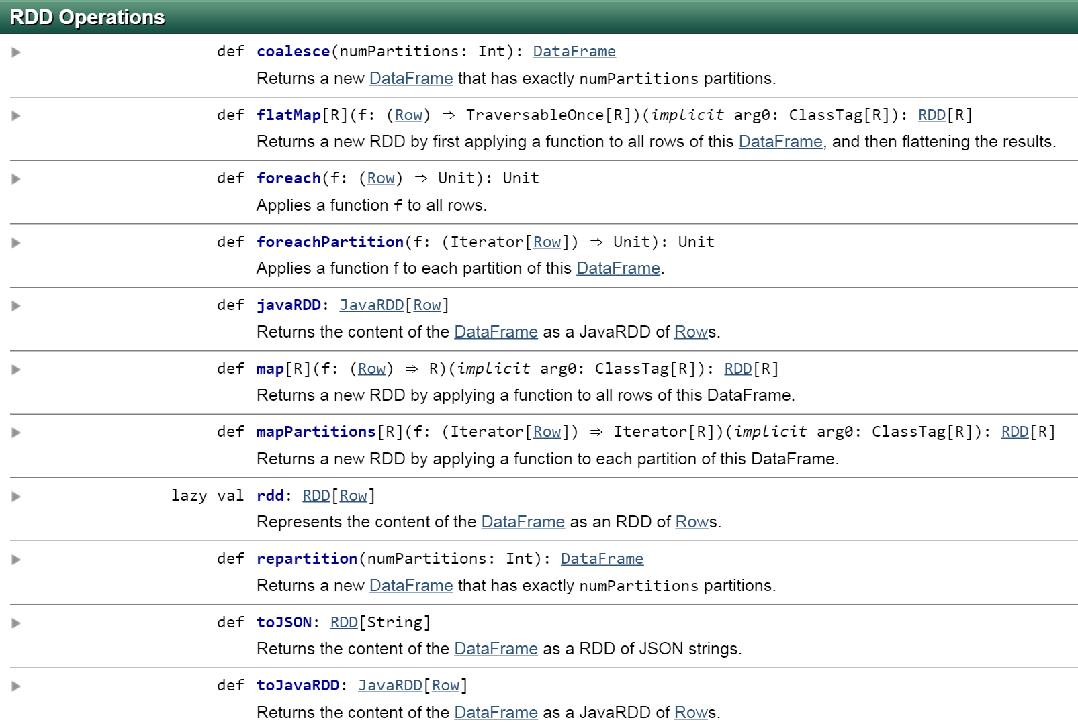
Operations on a DataFrame
Notes:
https://spark.apache.org/docs/latest/api/scala/index.html#org.apache.spark.sql.DataFrame
the full RDD API cannot be released on Dataframes. Per Michael, absolute freedom for users restricts the types of optimizations that we can do.

Slide 38

Creating DataFrames
Data Sources
E, T, M
E, T, M
E, T, M
E, T, M
E, T, M
E, T, M
RDD
- - -
- - -
- - -
E T M
E T M
E T M
E T M
E T M
E T M
DF

Slide 39
Data Sources API
Provides a pluggable mechanism for accessing structured data through Spark SQL
Tight optimizer integration means filtering and column pruning can often be pushed all the way down to data sources
Supports mounting external sources as temp tables
Introduced in Spark 1.2 via SPARK-3247

Slide 40
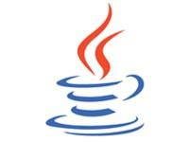



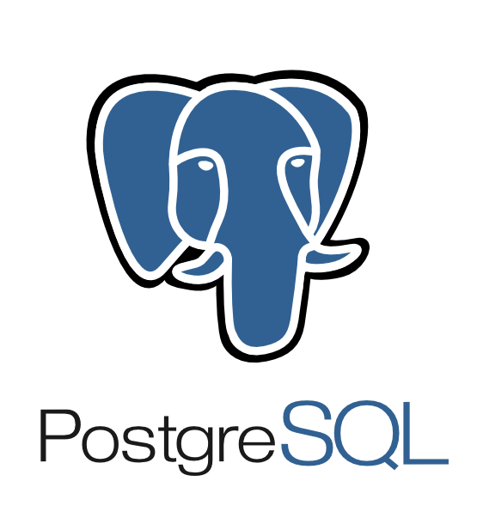






Write Less Code: Input & Output
Spark SQL’s Data Source API can read and write DataFrames using a variety of formats.
Built-In
External
{ JSON }
JDBC
and more…
Find more sources at http://spark-packages.org
40

Slide 41
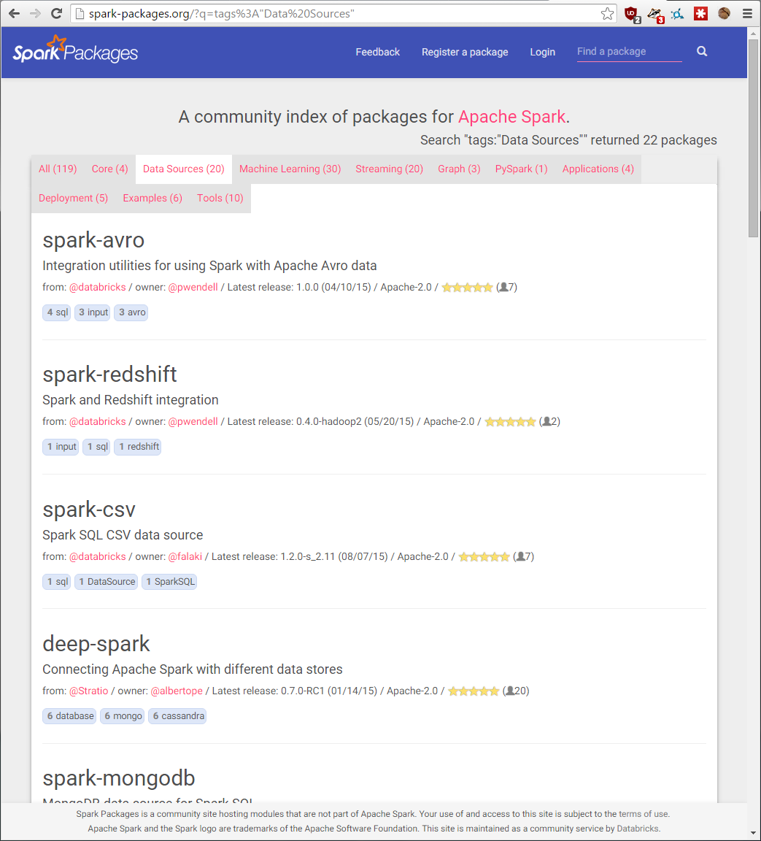
Spark Packages
Supported Data Sources:
Avro
Redshift
CSV
MongoDB
Cassandra
Cloudant
Couchbase
ElasticSearch
Mainframes (IBM z/OS)
Many More!

Slide 42
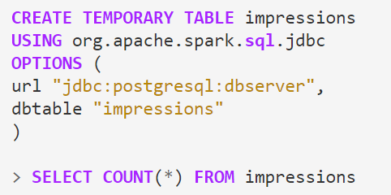
DataFrames: Reading from JDBC
1.3
Supports any JDBC compatible RDBMS: MySQL, PostGres, H2, etc
Unlike the pure RDD implementation (JdbcRDD), this supports predicate pushdown and auto-converts the data into a DataFrame
Since you get a DataFrame back, it’s usable in Java/Python/R/Scala.
JDBC server allows multiple users to share one Spark cluster
Notes:
Finally, a Data Source for reading from JDBC has been added as built-in source for Spark SQL. Using this library, Spark SQL can extract data from any existing relational databases that supports JDBC. Examples include mysql, postgres, H2, and more. Reading data from one of these systems is as simple as creating a virtual table that points to the external table. Data from this table can then be easily read in and joined with any of the other sources that Spark SQL supports.
This functionality is a great improvement over Spark’s earlier support for JDBC (i.e.,JdbcRDD). Unlike the pure RDD implementation, this new DataSource supports automatically pushing down predicates, converts the data into a DataFrame that can be easily joined, and is accessible from Python, Java, and SQL in addition to Scala.

Slide 43
Read Less Data
The fastest way to process big data is to never read it.
Spark SQL can help you read less data automatically:
Converting to more efficient formats
Using columnar formats (i.e. parquet)
Using partitioning (i.e., /year=2014/month=02/…)¹
Skipping data using statistics (i.e., min, max)²
Pushing predicates into storage systems (i.e., JDBC)

Slide 44



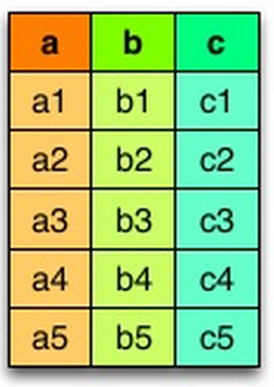
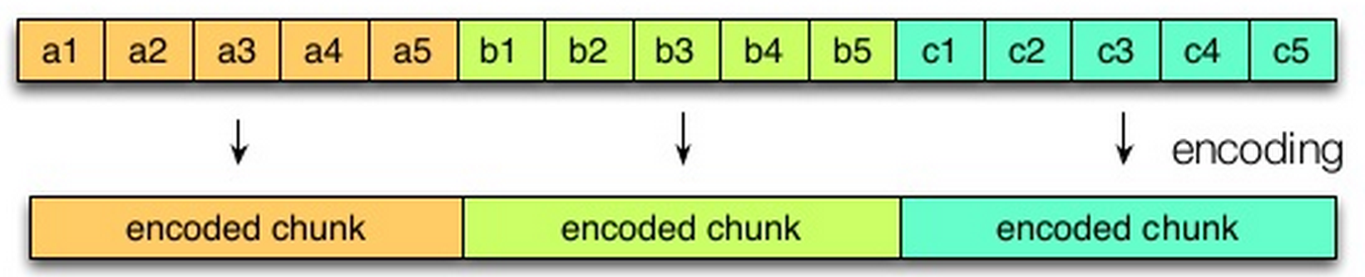
Fall 2012: &
July 2013: 1.0 release
May 2014: Apache Incubator, 40+ contributors
Limits I/O: Scans/Reads only the columns that are needed
Saves Space: Columnar layout compresses better
Logical table representation
Row Layout
Column Layout
Notes:
Twitter and Cloudera merged efforts in 2012 to develop a columnar format
Parquet is a column based storage format. It gets its name from the patterns in parquet flooring. Optimized use case for parquet is when you only need a subset of the total columns.
Avro is better if you typically scan/read all of the fields in a row in each query.
Typically, one of the most expensive parts of reading and writing data is (de)serialization. Parquet supports predicate push-down and schema projection to target specific columns in your data for filtering and reading — keeping the cost of deserialization to a minimum.
Parquet compresses better because columns have a fixed data type (like string, integer, Boolean, etc). it is easier to apply any encoding schemes on columnar data which could even be column specific such as delta encoding for integers and prefix/dictionary encoding for strings. Also, due to the homogeneity in data, there is a lot more redundancy and duplicates in the values in a given column. This allows better compression in comparison to data stored in row format.
The format is explicitly designed to separate the metadata from the data. This allows splitting columns into multiple files, as well as having a single metadata file reference multiple parquet files.
Ideal row group size: 512 MB – 1 GB. Since an entire row group might need to be read, we want it to completely fit on one HDFS block. Therefore, HDFS block sizes should also be set to be larger. An optimized read setup would be: 1GB row groups, 1GB HDFS block size, 1 HDFS block per HDFS file. Larger row groups allow for larger column chunks which makes it possible to do larger sequential IO. Larger groups also require more buffering in the write path (or a two pass write).
Data page size: 8 KB recommended. Data pages should be considered indivisible so smaller data pages allow for more fine grained reading (e.g. single row lookup). Larger page sizes incur less space overhead (less page headers) and potentially less parsing overhead (processing headers).
https://parquet.apache.org/documentation/latest/

Slide 45
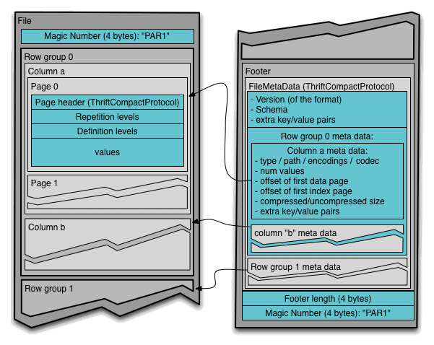
Reading:
Readers are expected to first read the file metadata to find all the column chunks they are interested in.
The columns chunks should then be read sequentially.
Writing:
Metadata is written after the data to allow for single pass writing.
Source: parquet.apache.org
Notes:
Row group: A logical horizontal partitioning of the data into rows. There is no physical structure that is guaranteed for a row group. A row group consists of a column chunk for each column in the dataset.
Column chunk: A chunk of the data for a particular column. These live in a particular row group and is guaranteed to be contiguous in the file.
Page: Column chunks are divided up into pages. A page is conceptually an indivisible unit (in terms of compression and encoding). There can be multiple page types which is interleaved in a column chunk.
Hierarchically, a file consists of one or more row groups. A row group contains exactly one column chunk per column. Column chunks contain one or more pages.
Metadata is written after the data to allow for single pass writing.
Readers are expected to first read the file metadata to find all the column chunks they are interested in. The columns chunks should then be read sequentially.
There are three types of metadata: file metadata, column (chunk) metadata and page header metadata. All thrift structures are serialized using the TCompactProtocol.
The format is explicitly designed to separate the metadata from the data. This allows splitting columns into multiple files, as well as having a single metadata file reference multiple parquet files.
Ideal row group size: 512 MB – 1 GB. Since an entire row group might need to be read, we want it to completely fit on one HDFS block. Therefore, HDFS block sizes should also be set to be larger. An optimized read setup would be: 1GB row groups, 1GB HDFS block size, 1 HDFS block per HDFS file. Larger row groups allow for larger column chunks which makes it possible to do larger sequential IO. Larger groups also require more buffering in the write path (or a two pass write).
Data page size: 8 KB recommended. Data pages should be considered indivisible so smaller data pages allow for more fine grained reading (e.g. single row lookup). Larger page sizes incur less space overhead (less page headers) and potentially less parsing overhead (processing headers).
https://parquet.apache.org/documentation/latest/

Slide 46
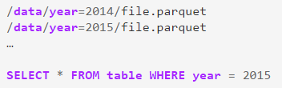
Parquet Features
Metadata merging
Allows developers to easily add/remove columns in data files
Spark will scan all metadata for files and merge the schemas
Auto-discover data that has been partitioned into folders
And then prune which folders are scanned based on predicates
So, you can greatly speed up queries simply by breaking up data into folders:
Notes:
First, organizations that store lots of data in parquet often find themselves evolving the schema over time by adding or removing columns. With this release we add a new feature that will scan the metadata for all files, merging the schemas to come up with a unified representation of the data. This functionality allows developers to read data where the schema has changed overtime, without the need to perform expensive manual conversions.
-
In Spark 1.4, we plan to provide an interface that will allow other formats, such as ORC, JSON and CSV, to take advantage of this partitioning functionality.

Slide 47
Write Less Code: Input & Output
Unified interface to reading/writing data in a variety of formats:
df = sqlContext.read \
.format("json") \
.option("samplingRatio", "0.1") \
.load("/home/michael/data.json")
df.write \
.format("parquet") \
.mode("append") \
.partitionBy("year") \
.saveAsTable("fasterData")

Slide 48
Write Less Code: Input & Output
Unified interface to reading/writing data in a variety of formats:
df = sqlContext.read \
.format("json") \
.option("samplingRatio", "0.1") \
.load("/home/michael/data.json")
df.write \
.format("parquet") \
.mode("append") \
.partitionBy("year") \
.saveAsTable("fasterData")
read and write functions create new builders for doing I/O

Slide 49
Write Less Code: Input & Output
Unified interface to reading/writing data in a variety of formats:
df = sqlContext.read \
.format("json") \
.option("samplingRatio", "0.1") \
.load("/home/michael/data.json")
df.write \
.format("parquet") \
.mode("append") \
.partitionBy("year") \
.saveAsTable("fasterData")
Builder methods specify:
Format
Partitioning
Handling of existing data
Notes:
On the builder you can specific methods…
Like do you want to overwrite data already there?
Load or save or saveAsTable are actions.

Slide 50
Write Less Code: Input & Output
Unified interface to reading/writing data in a variety of formats:
df = sqlContext.read \
.format("json") \
.option("samplingRatio", "0.1") \
.load("/home/michael/data.json")
df.write \
.format("parquet") \
.mode("append") \
.partitionBy("year") \
.saveAsTable("fasterData")
load(…), save(…) or saveAsTable(…) finish the I/O specification

Slide 51

How are statistics used to improve DataFrames performance?
Statistics are logged when caching
During reads, these statistics can be used to skip some cached partitions
InMemoryColumnarTableScan can now skip partitions that cannot possibly contain any matching rows
Predicate: a = 8
Filters Supported:
=, <, <=, >, >=
- - -
- - -
- - -
9 x x
4 x x
8 x x
8 x x
7 x x
2 x x
DF
max(a)=9
max(a)=7
max(a)=8
Reference:
https://github.com/apache/spark/pull/1883
https://github.com/apache/spark/pull/2188

Slide 52

DataFrame # of Partitions after Shuffle
- - -
- - -
- - -
- - -
- - -
E T M
E T M
E T M
E T M
E T M
E T M
E T M
E T M
E T M
E T M
DF-1
spark.sql.shuffle.partititions defaults to 200
Shuffle
sqlContex.setConf(key, value)
- - -
- - -
- - -
- - -
- - -
E T M
E T M
E T M
E T M
E T M
E T M
E T M
E T M
E T M
E T M
DF-2
Spark 1.6: Adaptive Shuffle
Notes:
Note that by default in Spark SQL, there is a parameter called spark.sql.shuffle.partititions, which sets the # of partitions in a Dataframe after a shuffle (in case the user didn't manually specify it). Currently, Spark does not do any automatic determination of partitions, it just uses the # in that parameter. Doing more automclasses for Databrick stuff is on our roadmap though. You can change this parameter using: sqlContex.setConf(key, value).
1.6 = adaptive shuffle, look at output of map side, then pick # of reducers. Matie and Yin's hack day project.

Slide 53
Caching a DataFrame
DF-1
.cache()
- - -
- - -
- - -
- - -
- - -
E T M
E T M
E T M
E T M
E T M
E T M
E T M
E T M
E T M
E T M
Spark SQL will re-encode the data into byte buffers before calling caching so that there is less pressure on the GC.

Slide 54
Demo!

Slide 55
Schema Inference
What if your data file doesn’t have a schema? (e.g., You’re reading a CSV file or a plain text file.)
You can create an RDD of a particular type and let Spark infer the schema from that type. We’ll see how to do that in a moment.
You can use the API to specify the schema programmatically.
(It’s better to use a schema-oriented input source if you can, though.)

Slide 56
Schema Inference Example
Suppose you have a (text) file that looks like this:
Erin,Shannon,F,42
Norman,Lockwood,M,81
Miguel,Ruiz,M,64
Rosalita,Ramirez,F,14
Ally,Garcia,F,39
Claire,McBride,F,23
Abigail,Cottrell,F,75 José,Rivera,M,59 Ravi,Dasgupta,M,25 …
The file has no schema, but it’s obvious there is one:
First name: string Last name: string Gender: string Age: integer
Let’s see how to get Spark to infer the schema.

Slide 57
Schema Inference :: Scala
import sqlContext.implicits._
case class Person(firstName: String,
lastName: String,
gender: String,
age: Int)
val rdd = sc.textFile("people.csv")
val peopleRDD = rdd.map { line =>
val cols = line.split(",")
Person(cols(0), cols(1), cols(2), cols(3).toInt)
}
val df = peopleRDD.toDF
// df: DataFrame = [firstName: string, lastName: string, gender: string, age: int]
Notes:
Case classes are used when creating classes that primarily hold data.
When your class is basically a data-holder, case classes simplify your
code and perform common work.
With case classes, unlike regular classes, we don’t have to use the
new keyword when creating an object.
The Scala interface for Spark SQL supports automatically converting an RDD containing case classes to a DataFrame. The case class defines the schema of the table. The names of the arguments to the case class are read using reflection (seen in green) and become the names of the columns. Case classes can also be nested or contain complex types such as Sequences or Arrays. This RDD can be implicitly converted to a DataFrame and then be registered as a table.
Note: Case classes in Scala 2.10 can support only up to 22 fields. To work around this limit, // you can use custom classes that implement the Product interface.
- - - -
What is a case class (vs a normal class)?
Original purpose was used for matching, but it’s used for more now
Scala’s version of a java bean (java has classes primary for data (gettings and settings) and there’s classes mostly for operations
Case classes are mostly for data
Scala can do reflection to establish/infer the schema of the df (seen in green).
You’d want to be more robust about parsing CSV in real life.
peopleRDD.toDF uses (a) Scala implicits and (b) the type of the RDD (RDD[Person]) to infer the schema
Mention that a case class, in Scala, is basically a Scala bean: A container for data, augmented with useful things by the Scala compiler.

Slide 58
A brief look at spark-csv
Let’s assume our data file has a header:
first_name,last_name,gender,age Erin,Shannon,F,42
Norman,Lockwood,M,81
Miguel,Ruiz,M,64
Rosalita,Ramirez,F,14
Ally,Garcia,F,39
Claire,McBride,F,23
Abigail,Cottrell,F,75 José,Rivera,M,59 Ravi,Dasgupta,M,25 …

Slide 59
A brief look at spark-csv
With spark-csv, we can simply create a DataFrame directly from our CSV file.
// Scala
val df = sqlContext.read.format("com.databricks.spark.csv").
option("header", "true").
load("people.csv")
# Python
df = sqlContext.read.format("com.databricks.spark.csv").\
load("people.csv", header="true")

Slide 60
DataFrames: Under the hood
Logical
Optimization
Physical
Planning
Code
Generation
Analysis
SQL AST
Unresolved Logical Plan
Logical Plan
Optimized Logical Plan
Physical Plans
Selected Physical Plan
RDDs
Cost Model
DataFrame
Catalog
DataFrames and SQL share the same optimization/execution pipeline
Notes:
Catalyst is a powerful new optimization framework. The Catalyst framework allows the developers behind Spark SQL to rapidly add new optimizations, enabling us to build a faster system more quickly.
Unlike the eagerly evaluated data frames in R and Python, DataFrames in Spark have their execution automatically optimized by a query optimizer called Catalyst.
Before any computation on a DataFrame starts, the Catalyst optimizer compiles the operations that were used to build the DataFrame into a physical plan for execution.

Slide 61
DataFrames: Under the hood
SQL AST
Unresolved Logical Plan
Logical Plan
Optimized Logical Plan
Physical Plans
Selected Physical Plan
RDDs
Cost Model
DataFrame
Catalog
DataFrame Operations
Selected Physical Plan
Notes:
Unlike the eagerly evaluated data frames in R and Python, DataFrames in Spark have their execution automatically optimized by a query optimizer called Catalyst.
Before any computation on a DataFrame starts, the Catalyst optimizer compiles the operations that were used to build the DataFrame into a physical plan for execution.

Slide 62
Catalyst Optimizations
Create Physical Plan & generate JVM bytecode
Logical Optimizations
Push filter predicates down to data source, so irrelevant data can be skipped
Parquet: skip entire blocks, turn comparisons on strings into cheaper integer comparisons via dictionary encoding
RDBMS: reduce amount of data traffic by pushing predicates down
Catalyst compiles operations into physical plans for execution and generates JVM bytecode
Intelligently choose between broadcast joins and shuffle joins to reduce network traffic
Lower level optimizations: eliminate expensive object allocations and reduce virtual function calls
Notes:
At a high level, there are two kinds of optimizations. First, Catalyst applies logical optimizations such as predicate pushdown. The optimizer can push filter predicates down into the data source, enabling the physical execution to skip irrelevant data. In the case of Parquet files, entire blocks can be skipped and comparisons on strings can be turned into cheaper integer comparisons via dictionary encoding. In the case of relational databases, predicates are pushed down into the external databases to reduce the amount of data traffic.
Second, Catalyst compiles operations into physical plans for execution and generatesJVM bytecode for those plans that is often more optimized than hand-written code. For example, it can choose intelligently between broadcast joins and shuffle joins to reduce network traffic. It can also perform lower level optimizations such as eliminating expensive object allocations and reducing virtual function calls. As a result, we expect performance improvements for existing Spark programs when they migrate to DataFrames.
Since the optimizer generates JVM bytecode for execution, Python users will experience the same high performance as Scala and Java users.

Slide 63
Not Just Less Code: Faster Implementations
https://gist.github.com/rxin/c1592c133e4bccf515dd
Notes:
Since the optimizer generates JVM bytecode for execution, Python users will experience the same high performance as Scala and Java users.
The above chart compares the runtime performance of running group-by-aggregation on 10 million integer pairs on a single machine (source code). Since both Scala and Python DataFrame operations are compiled into JVM bytecode for execution, there is little difference between the two languages, and both outperform the vanilla Python RDD variant by a factor of 5 and Scala RDD variant by a factor of 2.

Slide 64
Catalyst Goals
Make it easy to add new optimization techniques and features to Spark SQL
Enable developers to extend the optimizer
For example, to add data source specific rules that can push filtering or aggregation into external storage systems
Or to support new data types

Slide 65
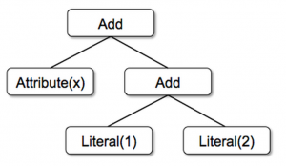
Catalyst: Trees
Imagine we have the following 3 node classes for a very simple expression language:
Tree: Main data type in Catalyst
Tree is made of node objects
Each node has type and 0 or more children
New node types are defined as subclasses of TreeNode class
Nodes are immutable and are manipulated via functional transformations
Literal(value: Int): a constant value
Attribute(name: String): an attribute from an input row, e.g.,“x”
Add(left: TreeNode, right: TreeNode): sum of two expressions.
Build a tree for the expression: x + (1+2)
In Scala code: Add(Attribute(x), Add(Literal(1), Literal(2)))
Notes:
At its core, Catalyst contains a general library for representing trees and applying rules to manipulate them.
A tree is just a Scala object.
- -
These classes can be used to build up trees; for example, the tree for the expression x+(1+2), would be represented in Scala code as follows: (See Scala code and Diagram)

Slide 66
Catalyst: Rules
Let’s implement a rule that folds Add operations between constants:
Rules: Trees are manipulated using rules
A rule is a function from a tree to another tree
Commonly, Catalyst will use a set of pattern matching functions to find and replace subtrees
Trees offer a transform method that applies a pattern matching function recursively on all nodes of the tree, transforming the ones that match each pattern to a result
tree.transform {
case Add(Literal(c1), Literal(c2)) => Literal(c1+c2)
}
Apply this to the tree: x + (1+2)
Yields: x + 3
The rule may only match a subset of all possible input trees
Catalyst tests which parts of a tree a given rule may apply to, and skips over or descends into subtrees that do not match
Rules don’t need to be modified as new types of operators are added
Notes:
Pattern matching is a feature of many functional languages that allows extracting values from potentially nested structures of algebraic data types.
-
The case keyword here is Scala’s standard pattern matching syntax, and can be used to match on the type of an object as well as give names to extracted values (c1 and c2 here).
-
The pattern matching expression that is passed to transform is a partial function, meaning that it only needs to match to a subset of all possible input trees.
This ability means that rules only need to reason about the trees where a given optimization applies and not those that do not match. Thus, rules do not need to be modified as new types of operators are added to the system.

Slide 67
Catalyst: Rules
Rules can match multiple patterns in the same transform call:
tree.transform {
case Add(Literal(c1), Literal(c2)) => Literal(c1+c2)
case Add(left, Literal(0)) => left
case Add(Literal(0), right) => right
}
Apply this to the tree: x + (1+2)
Apply this to the tree: (x+0) + (3+3)
Still yields: x + 3
Now yields: x + 6
Notes:
Rules (and Scala pattern matching in general) can match…
-
In the example above, repeated application would constant-fold larger trees, such as (x+0)+(3+3)

Slide 68
Catalyst: Rules
Rules may need to execute multiple times to fully transform a tree
Rules are grouped into batches
Each batch is executed to a fixed point (until tree stops changing)
Example:
Constant fold larger trees
Example:
First batch analyzes an expression to assign types to all attributes
Second batch uses the new types to do constant folding
Rule conditions and their bodies contain arbitrary Scala code
Takeaway: Functional transformations on immutable trees (easy to reason & debug)
Coming soon: Enable parallelization in the optimizer
Notes:
Examples below show why you may want to run a rule multiple times
Running rules to fixed point means that each rule can be simple and self-contained, and yet still eventually have larger global effects on a tree.
-
In our experience, functional transformations on immutable trees make the whole optimizer very easy to reason about and debug. They also enable parallelization in the optimizer, although we do not yet exploit this.

Slide 69
Using Catalyst in Spark SQL
Logical
Optimization
Physical
Planning
Code
Generation
Analysis
SQL AST
Unresolved Logical Plan
Logical Plan
Optimized Logical Plan
Physical Plans
Selected Physical Plan
RDDs
Cost Model
DataFrame
Catalog
Analysis: analyzing a logical plan to resolve references
Logical Optimization: logical plan optimization
Physical Planning: Physical planning
Code Generation: Compile parts of the query to Java bytecode
Notes:
In the physical planning phase, Catalyst may generate multiple plans and compare them based on cost.
All other phases are purely rule-based. Each phase uses different types of tree nodes; Catalyst includes libraries of nodes for expressions, data types, and logical and physical operators.
-
Does Catalyst currently have the capability to generate multiple physical plans? You had mentioned at TtT last week that costing is done eagerly to prune branches that are not allowed (aka greedy algorithm).
-
Greedy Algorithm works by making the decision that seems most promising at any moment; it never reconsiders this decision, whatever situation may arise later.
A greedy algorithm is an algorithm that follows the problem solving heuristic of making the locally optimal choice at each stage with the hope of finding a global optimum.

Slide 70
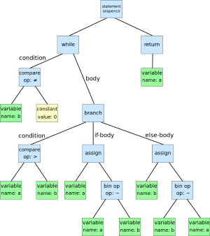
Catalyst: Analysis
Analysis
SQL AST
Unresolved Logical Plan
Logical Plan
DataFrame
- -
- -
- -
Catalog
DF
Relation may contain unresolved attribute references or relations
Example: “SELECT col FROM sales”
Type of col is unknown
Even if it’s a valid col name is unknown (till we look up the table)
Notes:
Spark SQL begins with a relation to be computed, either from an abstract syntax tree (AST) returned by a SQL parser, or from a DataFrame object constructed using the API.
A syntax tree is a tree representation of the structure of the source code. Each node of the tree denotes a construct occurring in the source code.
The syntax is "abstract" in not representing every detail appearing in the real syntax. For instance, grouping parentheses are implicit in the tree structure, and a syntactic construct like an if-condition-then expression may be denoted by means of a single node with three branches.
-
An abstract syntax tree for the following code for the Euclidean algorithm: while b ≠ 0if a > ba := a − belseb := b − areturn a
- -

Slide 71
Catalyst: Analysis
Analysis
Attribute is unresolved if:
Catalyst doesn’t know its type
Catalyst has not matched it to an input table
Catalyst will use rules and a Catalog object (which tracks all the tables in all data sources) to resolve these attributes
SQL AST
Unresolved Logical Plan
Logical Plan
DataFrame
Catalog
Analysis Rules
Step 1: Build “unresolved logical plan”
Look up relations by name in Catalog
Map named attributes (like col) to the input
Determine which attributes refer to the same value to give them a unique ID (for later optimizations)
Propagate and coerce types through expressions
We can’t know return type of 1 + col until we have resolved col
Step 2: Apply rules
Notes:
Spark SQL begins with a relation to be computed, either from an abstract syntax tree (AST) returned by a SQL parser, or from a DataFrame object constructed using the API.
A syntax tree is a tree representation of the structure of the source code. Each node of the tree denotes a construct occurring in the source code.
The syntax is "abstract" in not representing every detail appearing in the real syntax. For instance, grouping parentheses are implicit in the tree structure, and a syntactic construct like an if-condition-then expression may be denoted by means of a single node with three branches.
-
An abstract syntax tree for the following code for the Euclidean algorithm: while b ≠ 0if a > ba := a − belseb := b − areturn a
- -

Slide 72
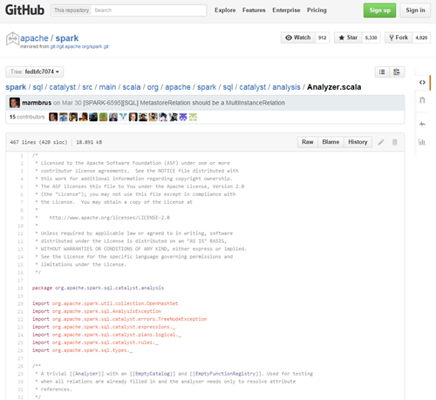
Catalyst: Analyer.scala
https://github.com/apache/spark/blob/fedbfc7074dd6d38dc5301d66d1ca097bc2a21e0/sql/catalyst/src/main/scala/org/apache/spark/sql/catalyst/analysis/Analyzer.scala
< 500 lines of code
Notes:
A trivial [[Analyzer]] with an [[EmptyCatalog]] and [[EmptyFunctionRegistry]]. Used for testing * when all relations are already filled in and the analyser needs only to resolve attribute * references.
* Provides a logical query plan analyzer, which translates [[UnresolvedAttribute]]s and * [[UnresolvedRelation]]s into fully typed objects using information in a schema [[Catalog]] and * a [[FunctionRegistry]].

Slide 73
Catalyst: Logical Optimizations
Logical
Optimization
Applies rule-based optimizations to the logical plan:
Constant folding
Predicate pushdown
Projection pruning
Null propagation
Boolean expression simplification
[Others]
Example: a 12-line rule optimizes LIKE expressions with simple regular expressions into String.startsWith or String.contains calls.
Logical Plan
Optimized Logical Plan
Notes:
Note, this is not cost based. Cost-based optimization is performed by generating multiple plans using rules, and then computing their costs.

Slide 74
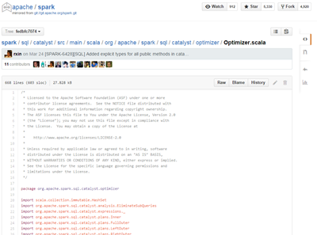
Catalyst: Optimizer.scala
https://github.com/apache/spark/blob/fedbfc7074dd6d38dc5301d66d1ca097bc2a21e0/sql/catalyst/src/main/scala/org/apache/spark/sql/catalyst/optimizer/Optimizer.scala
< 700 lines of code
Notes:
A trivial [[Analyzer]] with an [[EmptyCatalog]] and [[EmptyFunctionRegistry]]. Used for testing * when all relations are already filled in and the analyser needs only to resolve attribute * references.
* Provides a logical query plan analyzer, which translates [[UnresolvedAttribute]]s and * [[UnresolvedRelation]]s into fully typed objects using information in a schema [[Catalog]] and * a [[FunctionRegistry]].

Slide 75
Catalyst: Physical Planning
Physical
Planning
Spark SQL takes a logical plan and generations one or more physical plans using physical operators that match the Spark Execution engine:
mapPartitions()
new ShuffledRDD
zipPartitions()
Currently cost-based optimization is only used to select a join algorithm
Broadcast join
Traditional join
Physical planner also performs rule-based physical optimizations like pipelining projections or filters into one Spark map operation
It can also push operations from logical plan into data sources (predicate pushdown)
Optimized Logical Plan
Physical Plans
Notes:
The framework supports broader use of cost-based optimization, however, as costs can be estimated recursively for a whole tree using a rule. We thus intend to implement richer cost-based optimization in the future.

Slide 76
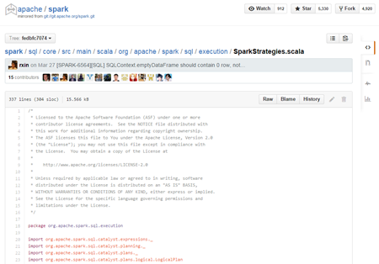
Catalyst: SparkStrategies.scala
https://github.com/apache/spark/blob/fedbfc7074dd6d38dc5301d66d1ca097bc2a21e0/sql/core/src/main/scala/org/apache/spark/sql/execution/SparkStrategies.scala
< 400 lines of code
Notes:
A trivial [[Analyzer]] with an [[EmptyCatalog]] and [[EmptyFunctionRegistry]]. Used for testing * when all relations are already filled in and the analyser needs only to resolve attribute * references.
* Provides a logical query plan analyzer, which translates [[UnresolvedAttribute]]s and * [[UnresolvedRelation]]s into fully typed objects using information in a schema [[Catalog]] and * a [[FunctionRegistry]].

Slide 77
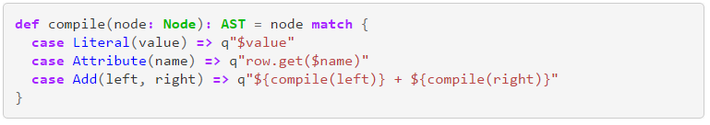
Catalyst: Code Generation
Code
Generation
Generates Java bytecode to run on each machine
Catalyst relies on janino to make code generation simple
(FYI - It used to be quasiquotes, but now is janino)
Selected Physical Plan
RDDs
This code gen function converts an expression
like (x+y) + 1 to a Scala AST:
Notes:
As a simple example, consider the Add, Attribute and Literal tree nodes introduced in Section 4.2, which allowed us to write expressions such as (x+y)+1.
Without code generation, such expressions would have to be interpreted for each row of data, by walking down a tree of Add, Attribute and Literal nodes. This introduces large amounts of branches and virtual function calls that slow down execution. With code generation, we can write a function to translate a specific expression tree to a Scala AST as follows:
The strings beginning with q are quasiquotes, meaning that although they look like strings, they are parsed by the Scala compiler at compile time and represent ASTs for the code within. Quasiquotes can have variables or other ASTs spliced into them, indicated using $ notation. For example, Literal(1) would become the Scala AST for 1, whileAttribute("x") becomes row.get("x"). In the end, a tree like Add(Literal(1), Attribute("x")) becomes an AST for a Scala expression like 1+row.get("x").

Slide 78
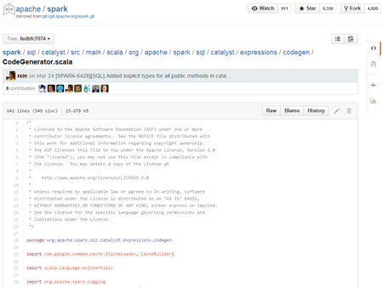
Catalyst: CodeGenerator.scala
https://github.com/apache/spark/blob/fedbfc7074dd6d38dc5301d66d1ca097bc2a21e0/sql/catalyst/src/main/scala/org/apache/spark/sql/catalyst/expressions/codegen/CodeGenerator.scala
< 700 lines of code
Notes:
A trivial [[Analyzer]] with an [[EmptyCatalog]] and [[EmptyFunctionRegistry]]. Used for testing * when all relations are already filled in and the analyser needs only to resolve attribute * references.
* Provides a logical query plan analyzer, which translates [[UnresolvedAttribute]]s and * [[UnresolvedRelation]]s into fully typed objects using information in a schema [[Catalog]] and * a [[FunctionRegistry]].

Slide 79
Seamlessly Integrated
Intermix DataFrame operations with
custom Python, Java, R, or Scala code
zipToCity = udf(lambda zipCode: <custom logic here>)
def add_demographics(events):
u = sqlCtx.table("users")
events \
.join(u, events.user_id == u.user_id) \
.withColumn("city", zipToCity(df.zip))
Augments any DataFrame that contains user_id
Notes:
Sometimes you want to call complex functions to do additional work inside of the SQL queries.
UDFs can be inlined in the DataFrame code
UDF zipToCity just invokes a lamda function that takes a zipCode and does some custom logic to figure out which city the zip code is located in.
I have a function called add demographics, which takes a data frame w/ a user ID and will automatically compute a bunch of demographic information.
So, we do a join based on UserID and then adds a new column with the .withColumn… the UDF results will add a new column.
This def returns a new DataFrame

Slide 80
Optimize Entire Pipelines
Optimization happens as late as possible, therefore Spark SQL can optimize even across functions.
events = add_demographics(sqlCtx.load("/data/events", "json"))
training_data = events \
.where(events.city == "San Francisco") \
.select(events.timestamp) \
.collect()
Notes:
All of this is lazy, so SparkSQL can do optimizations much later.
For this type of machine learning I’m doing, I may only need the ts column from San Francisco.
Note that add_demographics does have extra functionality to filter down to just SF and ts.

Slide 81
def add_demographics(events):
u = sqlCtx.table("users") # Load Hive table
events \
.join(u, events.user_id == u.user_id) \ # Join on user_id
.withColumn("city", zipToCity(df.zip)) # Run udf to add city column
events = add_demographics(sqlCtx.load("/data/events", "json"))
training_data = events.where(events.city == "San Francisco").select(events.timestamp).collect()
Logical Plan
Physical Plan
filter
join
only join relevent users
join
scan
(events)
filter
expensive
events file
users table
scan
(users)
81
Notes:
So maybe add_demographics was by my co-worker and I just want to use it.
So we construct a logical query plan.
Since this planning is happening at the logical level, optimizations can even occur across function calls, as shown in the example below.
In this example, Spark SQL is able to push the filtering of users by their location through the join, greatly reducing its cost to execute. This optimization is possible even though the original author of the add_demographics function did not provide a parameter for specifying how to filter users!
-
Ideally we want to filter the users ahead of time based on the extra predicates, and only do the join on the relevent users.

Slide 82
def add_demographics(events):
u = sqlCtx.table("users") # Load partitioned Hive table
events \
.join(u, events.user_id == u.user_id) \ # Join on user_id
.withColumn("city", zipToCity(df.zip)) # Run udf to add city column
events = add_demographics(sqlCtx.load("/data/events", "parquet"))
training_data = events.where(events.city == "San Francisco").select(events.timestamp).collect()
Physical Plan
Optimized Physical Plan
with Predicate Pushdown and Column Pruning
Logical Plan
filter
join
join
join
scan
(events)
filter
optimized
scan
(events)
optimized scan
(users)
events file
users table
scan
(users)
82
Notes:
Even cooler, if I want to optimize this later on…
So, here I changed to a partitioned hive table (users) and also used parquet instead of JSON (events).
Now with Parquet, SparkSQL notices there are new optimizations that it can now do

Slide 83
Spark 1.5 –Speed / Robustness
Project Tungsten
Tightly packed binary structures
Fully-accounted memory with automatic spilling
Reduced serialization costs
Notes:
Idea of Project Tungsten is to reimagine the execution engine for SparkSQL
As a user, when you move to 1.5 you will see significant robustness and speed improvements

Slide 84


Spark 1.5 – Improved Function Library
100+ native functions with optimized codegen implementations
String manipulation – concat, format_string, lower, lpad
Data/Time – current_timestamp, date_format, date_add
Math – sqrt, randn
Other – monotonicallyIncreasingId, sparkPartitionId
from pyspark.sql.functions import *
yesterday = date_sub(current_date(), 1)
df2 = df.filter(df.created_at > yesterday)
import org.apache.spark.sql.functions._
val yesterday = date_sub(current_date(), 1)
val df2 = df.filter(df("created_at") > yesterday)
Notes:
Before you had to resort to Hive UDFs or drop into SQL…
But now there are 100+ native functions added that at runtime Java bytecode will be constructed to evaluate whatever you need.

Slide 85
Window Functions
Before Spark 1.4:
2 kinds of functions in Spark that could return a single value:
Built-in functions or UDFs (round)
take values from a single row as input, and they generate a single return value for every input row
Aggregate functions (sum or max)
operate on a group of rows and calculate a single return value for every group
New with Spark 1.4:
Window Functions (moving avg, cumulative sum)
operate on a group of rows while still returning a single value for every input row.

Slide 86
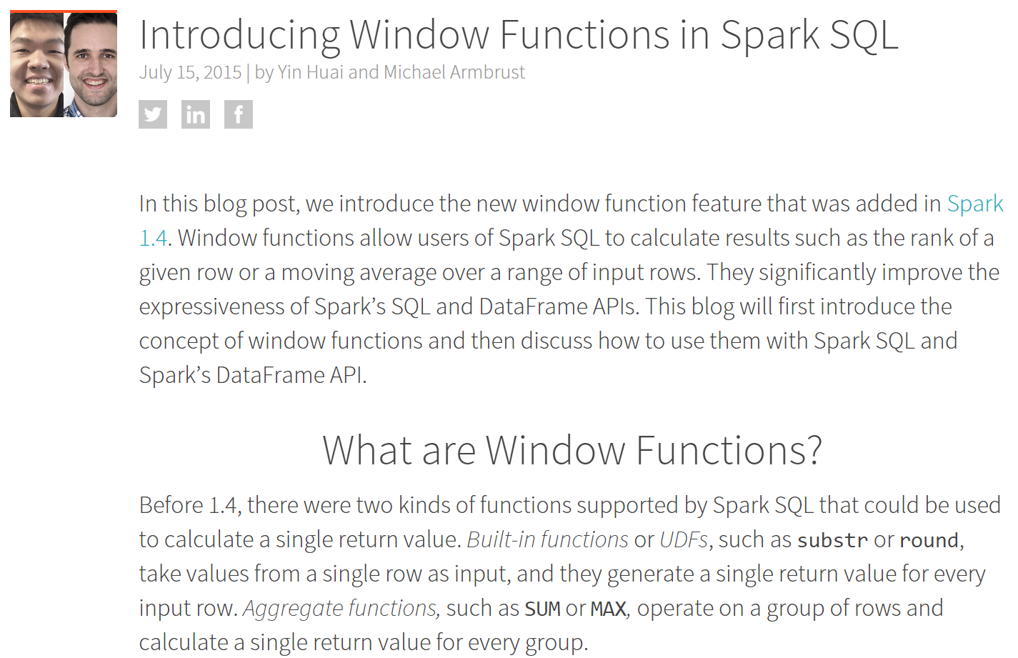

Slide 87
Streaming DataFrames
Umbrella ticket to track what's needed to make streaming DataFrame a reality:
https://issues.apache.org/jira/browse/SPARK-8360
Notes:
Pass a physical plan generated by Catalyst into Streaming

